Slide 1

CG1112
Engineering Principles and Practices II for CEG
Week 5 Studio 1
Timers
colintan@nus.edu.sg

Slide 2
Timer Programming
Timers are important in real-time systems:
They allow us to read sensors or write to actuators at precise times.
They ensure that time-sensitive algorithms (e.g. the PID control algorithm) run at the correct timing.
Timers are often needed to switch between tasks in a multi-tasking OS (more in CG2271).
Timers are used to generate analog output signals through pulse-width modulation (PWM).

Slide 3
Timers in the Atmega AVR
There are 3 timers available on the Atmega328:
Two 8-bit timers, Timers 0 and 2.
Counts from 0 to 255, then back to 0, etc.
Triggers an interrupt (TOV0 or TOV2) whenever the counter rolls over from 255 to 0. Also triggers interrupts if counter matches a value.
One 16-bit timer, Timer 1.
Counts from 0 to 65535 and back to 0, etc.
Triggers an interrupt (TOV1) whenever the counter rolls over from 65535 to 0. Also triggers interrupts if counter matches a value.
In this lecture we will focus on Timer 0.
Techniques for Timer 1 and 2 are identical, just with different registers.
We will also look at how to generate waveforms on the OC0A and OC0B pins (corresponding to PD5 and PD6) on the AVR.
This is not usually necessary but we do it just for demo purposes.

Slide 4
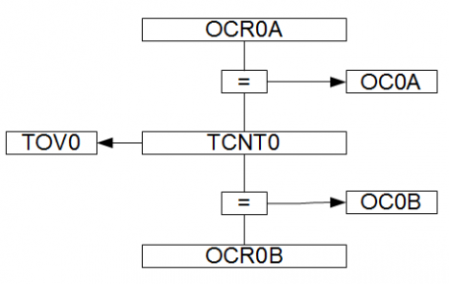
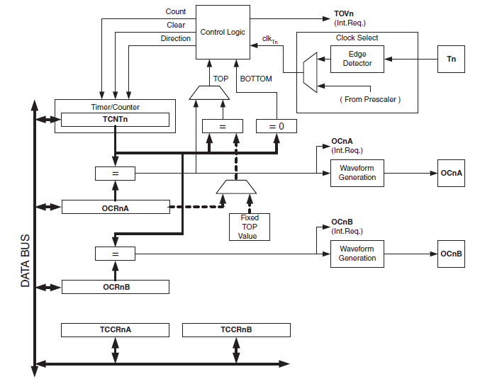
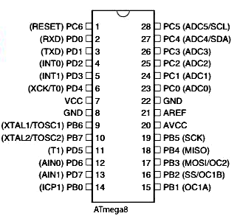
Timer 0/Timer 2 Block Diagram
Diagram Credits: Midity. http://www.midity.com
PD6
PD5

Slide 5
Timer 0 Programming CTC Mode
The (second) simplest timer mode is CTC (Clear Timer on Compare) mode.
Counter TCNT0 starts at 0, counts to a preset “top value” V, then rolls over back to the 0. Process repeats.
A “timer match” interrupt is triggered each time TCNT0 matches OCR0A or OCR0B.
This is very useful for generating an interrupt at fixed times, e.g. every 1 ms.
Perfect for devices that need to be read at fixed times.
Perfect also for programs that need to “sleep” for fixed times.

Slide 6
Timer 0 Programming CTC Mode
To program CTC mode in Timer 0, you need to:
Decide on the time period that you want, e.g. 1 ms.
From this:
Decide on a prescaler value P and count value V.
These are done simultaneously, subject to I/O clock rate and register size restrictions.
Configure the registers.
Set up the ISR for OC0A (Timer 0 Output Compare Match A).
Set the initial timer value of 0 into TCNT0.
Set the top count value V into OCR0A.
Set CTC mode in TCCR0A.
Set the prescaler into TCCR0B to start the timer.

Slide 7
Timer 0 Programming CTC Mode
Deciding on a prescaler value P
This determines the resolution res of the timer. I.e. the amount of time between “increments” of the counter.
The prescalar frequency is given by:
The resolution for the prescalar is given by the 1 / res (see next slide).

Slide 8
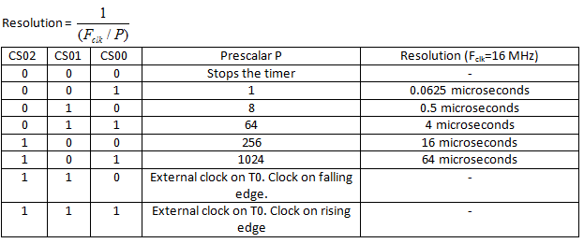
Timer 0 Programming CTC Mode
The prescalar is chosen using bits 2 to 0(CS02:00) of TCCR0B:

Slide 9
Timer 0 Programming CTC Mode
The TIMER0_COMPA (TIMER0_COMPA_vect) interrupt is triggered whenever TCNT0 reaches the top timer value V and rolls back to 0.
We first decide the period T_{cycle}, which is the time which the timer triggers the timer interrupt.
We need to decide what V is!
We want our TIMER0_COMPA interrupt to be triggered every 1 ms, or 1000 microseconds. Using the formula above, the possible values are shown in the table on the next page.

Slide 10
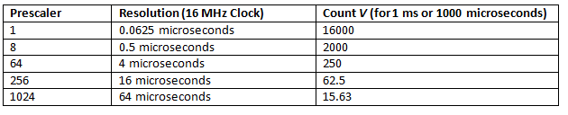
Timer 0 Programming CTC Mode
The possible V are:
It is not possible to load 16000 or 2000 into 8-bit registers. The possible values are 250, 62.5 and 15.63.
We choose the largest value 250 because it gives us the best possible resolution of 4 microseconds.
Better resolution = more accurate timings.
This gives us a prescaler value of 64.

Slide 11
Timer 0 Programming CTC Mode
Now that we have chosen P and V, we can begin configuring the timer.
Set the initial timer value in the Timer 0 Control register TCNT0. We use an initial value of 0.
TCNT0=0;
Set the timer value V into the Output Compare Register OCR0A. For 250 steps, V=249, since we start from 0.
OCR0A=249;

Slide 12

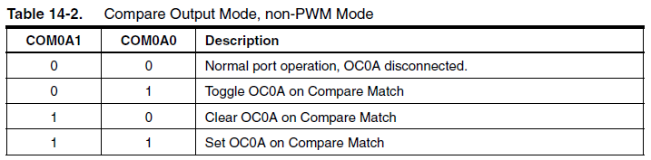
Timer 0 Programming CTC Mode
Set up Timer/Counter Control Register TCCR0A:
COM0A1 and COM0A0 control what to do with OC0A each time we hit the top value V in OCR0A:
We want to toggle OC0A on match, so we choose CM0A1 and COM0A0 to “01” respectively.
https://www.darpa.mil/news-events/2020-01-10

Slide 13
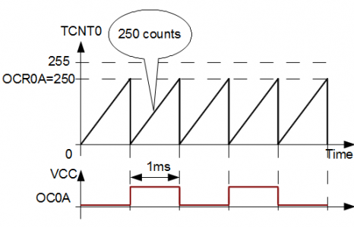
Timer 0 Programming CTC Mode
Diagram Credits: Midity. http://www.midity.com/

Slide 14
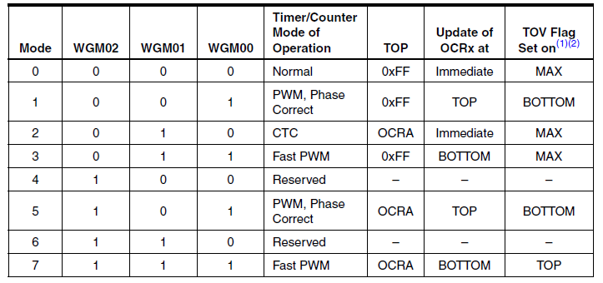
Timer 0 Programming CTC Mode
Set up Timer/Counter Control Register TCCR0A:
The WGM00, WGM01 and WGM02 bits control the waveform generation:
We will use CTC mode so WGM01 and WGM00 are “10”. WGM02 is in TCCR0B.

Slide 15

Timer 0 Programming CTC Mode
Taken together, we will program TCCR0A using the following statement:
TCCR0A=0b01000010;
We need to enable the OCIE0A interrupt (output compare match A) by writing a 1 to bit 1 of the Timer/Counter Interrupt Mask Register TIMSK0:
TIMSK0|=0b10;

Slide 16

Timer 0 Programming CTC Mode
Finally we will start the timer by writing selecting the prescaler value P in TCCR0B, using bits CS02:CS00.
We want a prescaler value of 64 so we use 011.
We also want WGM02 to be 0 (see previous slide).
TCCR0B=0b00000011;
Note: Setting CS02:CS00 bits to anything other than 000 automatically begins the timer.
We must also enable global interrupts using the sei(); function call.

Slide 17
Timer 0 Programming CTC Mode
We will now look at an example program that:
Increments a counter every millisecond.
On every 100th increment, it toggles an LED at pin 13 on or off.
Effectively causes the LED to blink on and off every 100 ms.

Slide 18
Timer 0 Programming CTC Mode Example 1
#include <avr/io.h>
#include <avr/interrupt.h>
int count;
//Initialize Timer0
void InitTimer0(void)
{
//Set Initial Timer value
TCNT0=0;
//Place TOP timer value to Output compare register
OCR0A=249;
//Set CTC mode
// and make toggle PD6/OC0A pin on compare match
TCCR0A=0b01000010;
// Enable interrupts.
TIMSK0|=0b10;
}

Slide 19
Timer 0 Programming CTC Mode Example 1
void StartTimer0(void)
{
//Set prescaler 64 and start timer
TCCR0B=0b00000011;
// Enable global interrupts
sei();
}
void ledOn()
{
PORTB|=0b00100000;
}
void ledOff()
{
PORTB&=0b11011111;
}

Slide 20
Timer 0 Programming CTC Mode Example 1
// Toggle the LED
void toggleLED()
{
static state=1;
if(state==1)
{
ledOn();
state==0;
}
else
{
ledOff();
state=1;
}
}

Slide 21
Timer 0 Programming CTC Mode Example 1
// Set up the ISR for TOV0A
ISR(TIMER0_COMPA_vect)
{
count++;
if((count % 100)==0)
toggleLED();
}
int main(void)
{
// Set up LED on pin 13 (port B pin 5) for output.
DDRB|=0b00100000;
count=0;
InitTimer0();
StartTimer0();
while(1)
{ // Do nothing.
}
}

Slide 22
Timer Programming in General
Programming on Timer 2 is exactly the same, but with different register names.
E.g. use TCCR2A, TCCR2B, TCNT2, OCR2A, etc.
Timer 1 is a 16-bit timer, giving you better resolution.
We can load a value of 16000 into OCR1AH/OCR1AL to get a 1ms count, allowing use to use a prescaler of 1 and a resolution of 0.0625 microseconds.
This can potentially lead to more accurate timings.

Slide 23
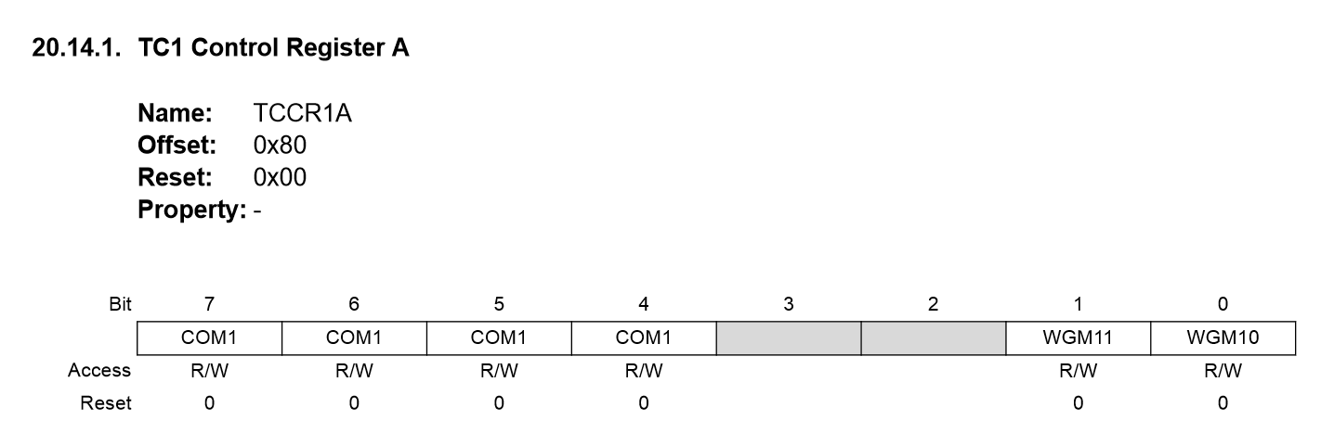
Timer Programming in General
However the register layout is slightly different:
TCNT1 and OCR1A/OCR1B are all now 16 bit registers.
Different layout for TCCR1A and TCCR1B:

Slide 24
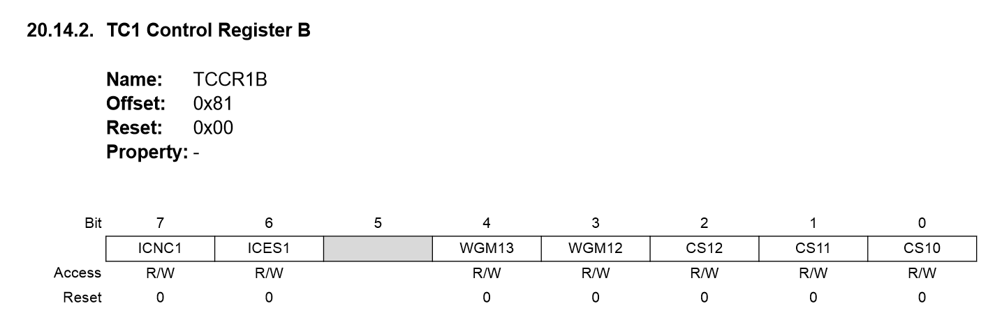
Timer Programming in General
However the register layout is slightly different:
TCNT1 and OCR1A/OCR1B are all now 16 bit registers.
Different layout for TCCR1A and TCCR1B:

Slide 25
Timer Programming in General
Some notable differences:
The WGM bits are now 4 bits long instead of 3.
WGM10 and WGM11 are in TCCR1A, WGM12 and WGM13 are in TCCR1B
Presence of new ICNC1 and ICES1 bits in TCCR1B:
ICNC is for noise removal, ICES allows external control of the waveform. We don’t need these so set them to 0.
Table on the next slide shows the WGM bits for Timer 1:

Slide 26
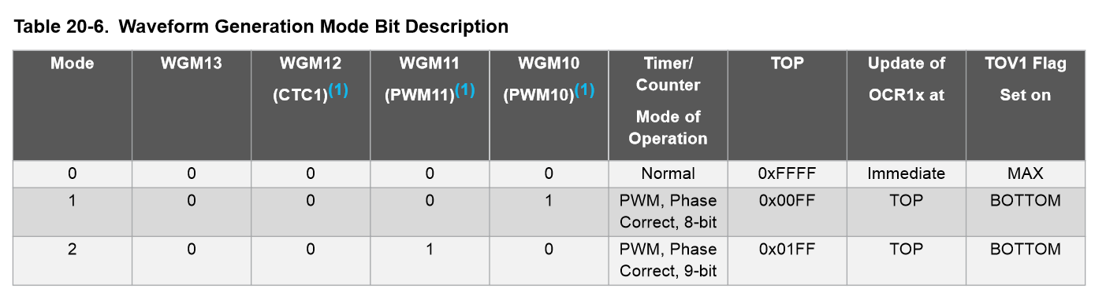
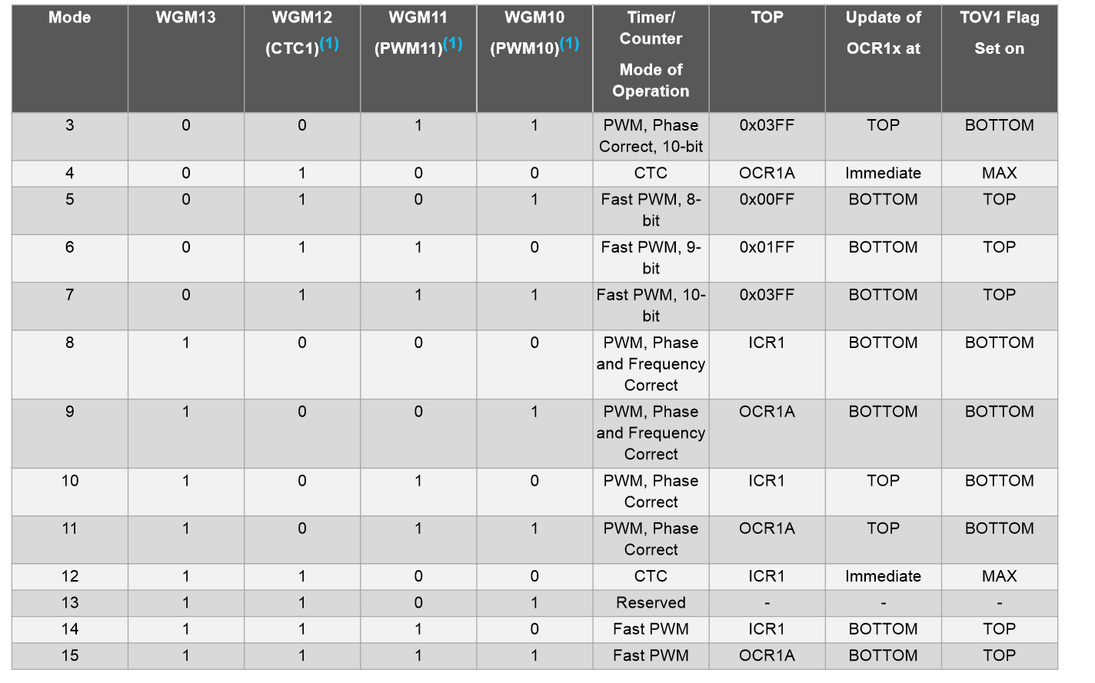
Timer Programming in General

